Slide 1
Locality Sensitive Hashing
LSH

Slide 2
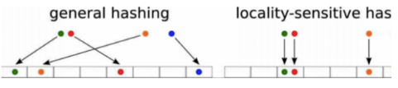

Slide 3
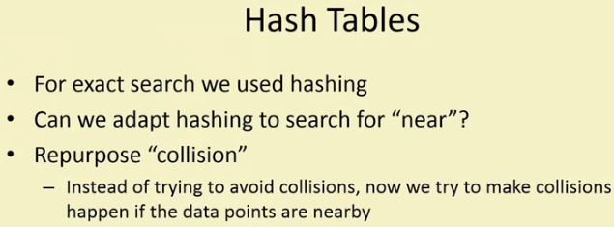

Slide 4
LSH refers to a family of functions (known as LSH families) to hash data points into buckets so that data points near each other are located in the same buckets with high probability,
while data points far from each other are likely to be in different buckets. This makes it easier to identify observations with various degrees of similarity.

Slide 5
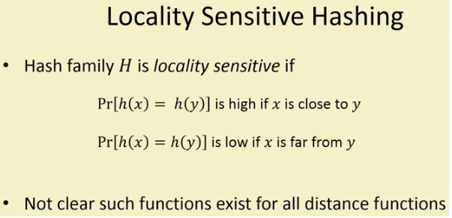

Slide 6
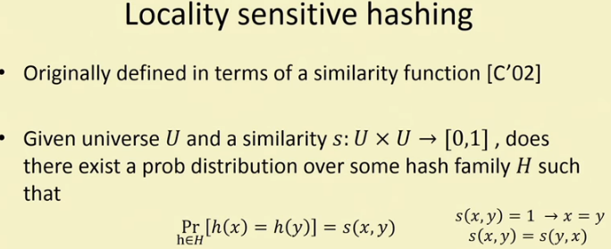

Slide 7
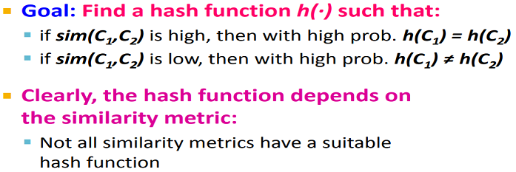

Slide 8
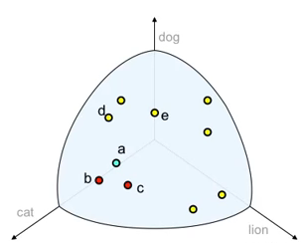

Slide 9
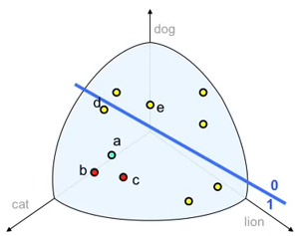

Slide 10
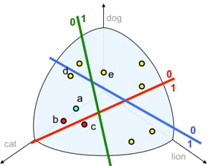


Slide 11
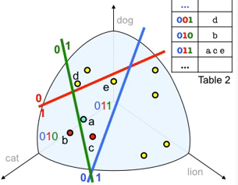

Slide 12
LSH
Locality Sensitive hashing is the general idea of hashing items into bins, many times, and looking only at those items that fall into same bin, at least once.

Slide 13
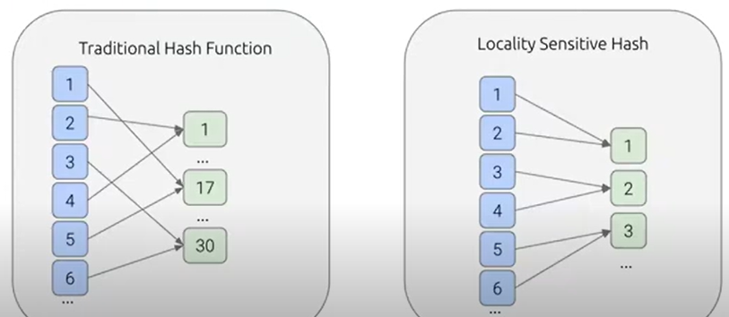

Slide 14
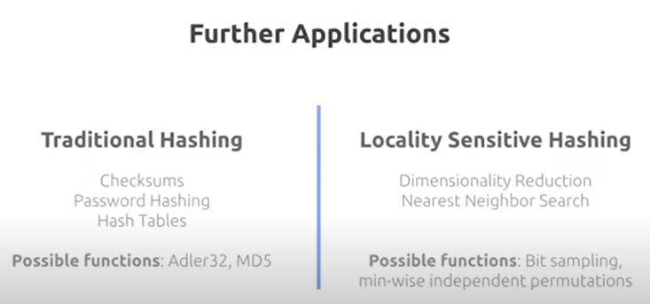

Slide 15
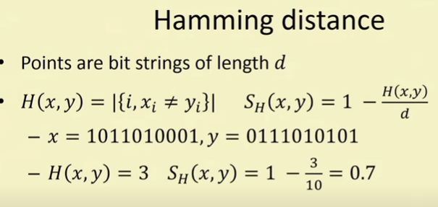

Slide 16
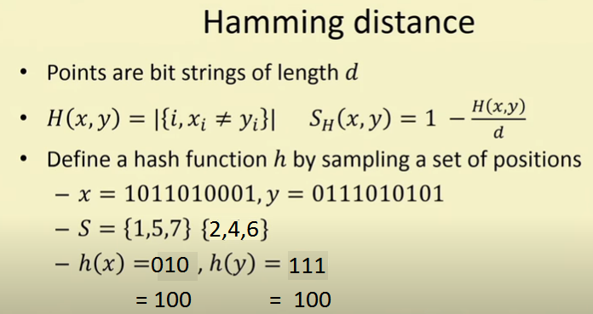

Slide 17
Existence of LSH
This proves for very simple distance or similarity function, family of Locality Hash functions can be designed.

Slide 18
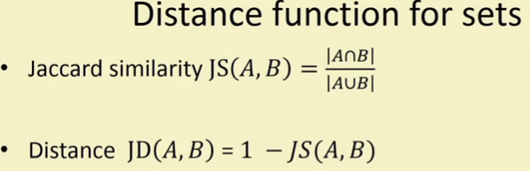
LSH for Jaccard Similarity

Slide 19
Min-Hashing
There is a suitable hash function for the Jaccard similarity:
It is called Min-Hashing
Refer notes for solved example of Min hashing.

Slide 20
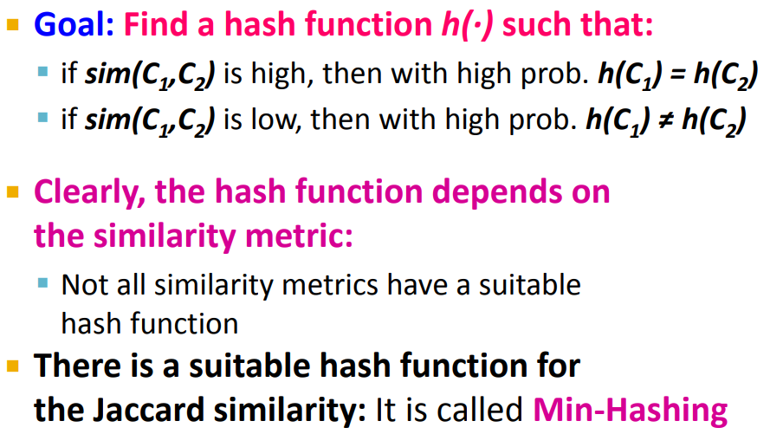
Min-Hashing

Slide 21
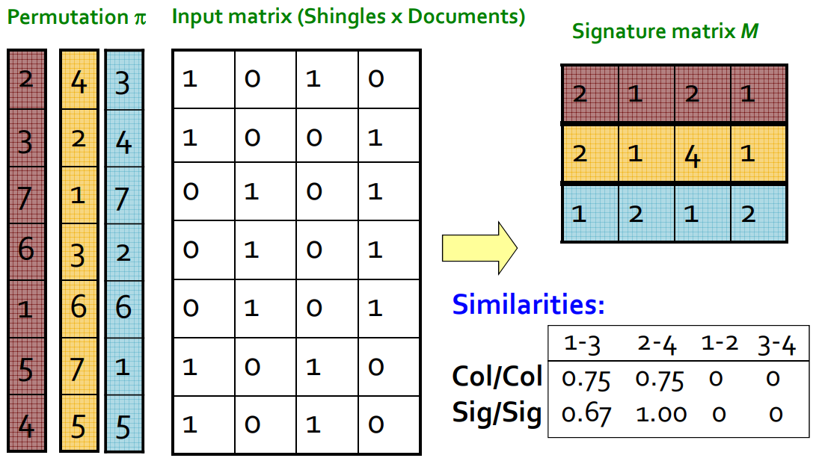

Slide 22
The probability of over all permutations of the rows that
h(C1) = h(C2) is the same as Jaccard similarity(C1,C2)
Thus we conclude, Hash family H, which will preserve the notion of LSH can be designed for Jaccard similarity.

Slide 23
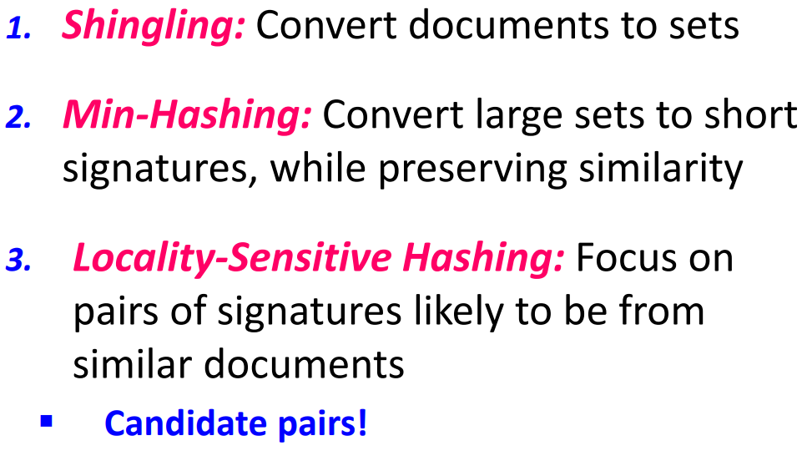
LSH for finding similar documents

Slide 24
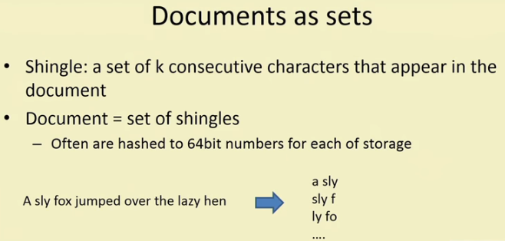
Shingle of size 5, with sliding window of size 5
Notes:
‹#›

Slide 25
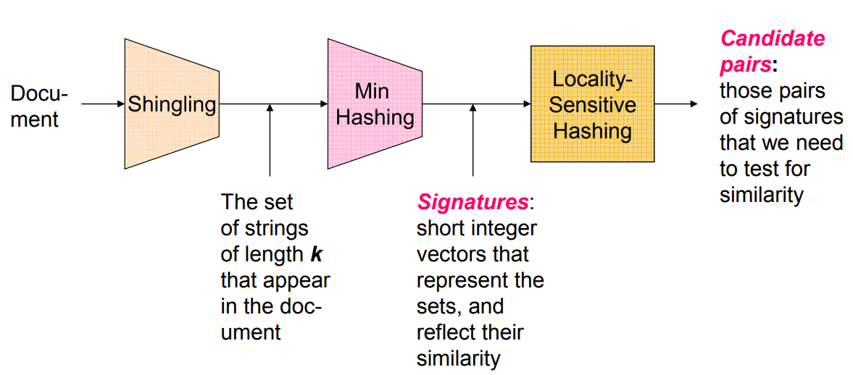

Slide 26
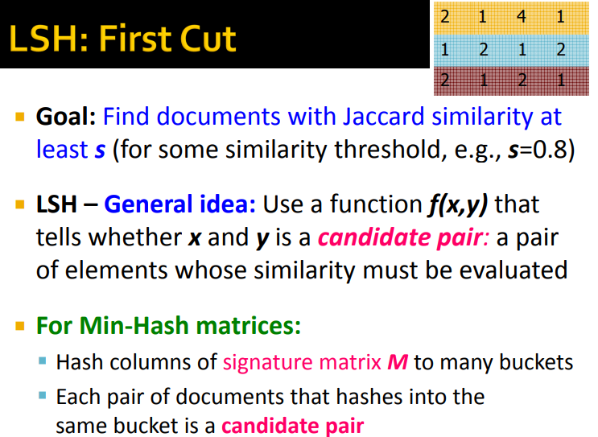

Slide 27
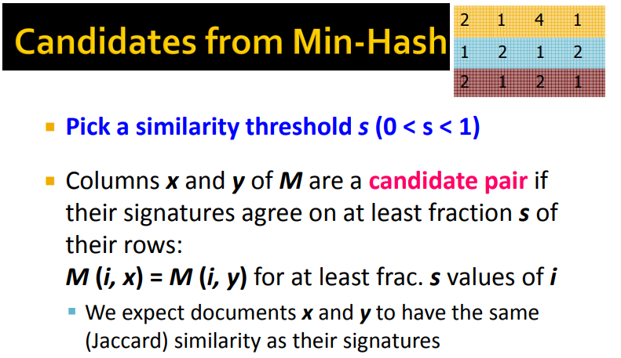

Slide 28
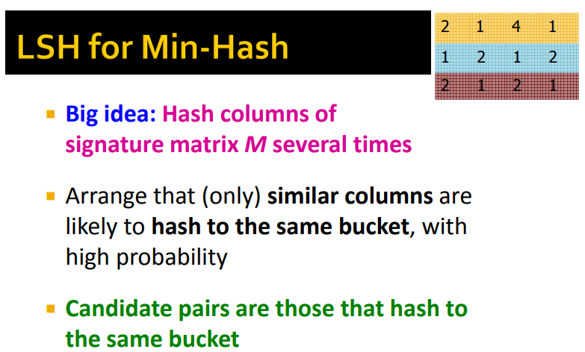

Slide 29
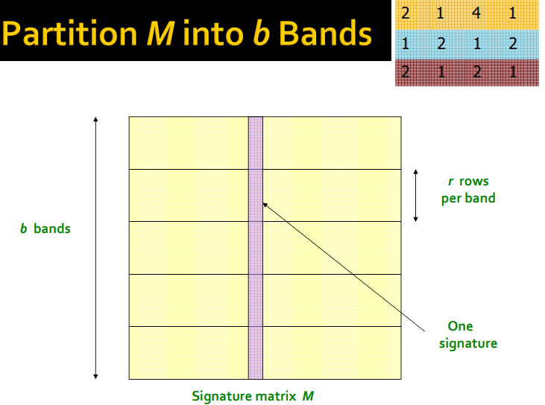

Slide 30
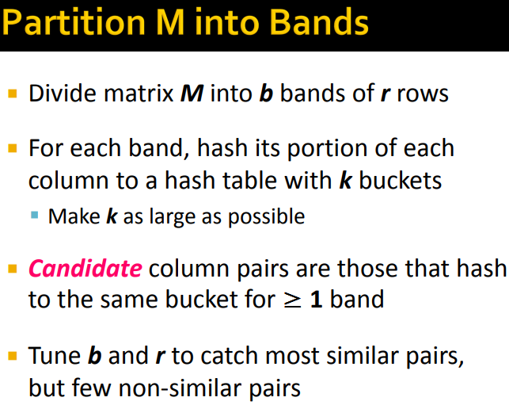

Slide 31
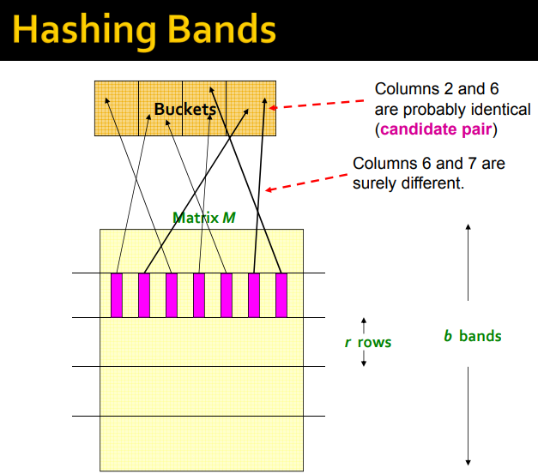

Slide 32
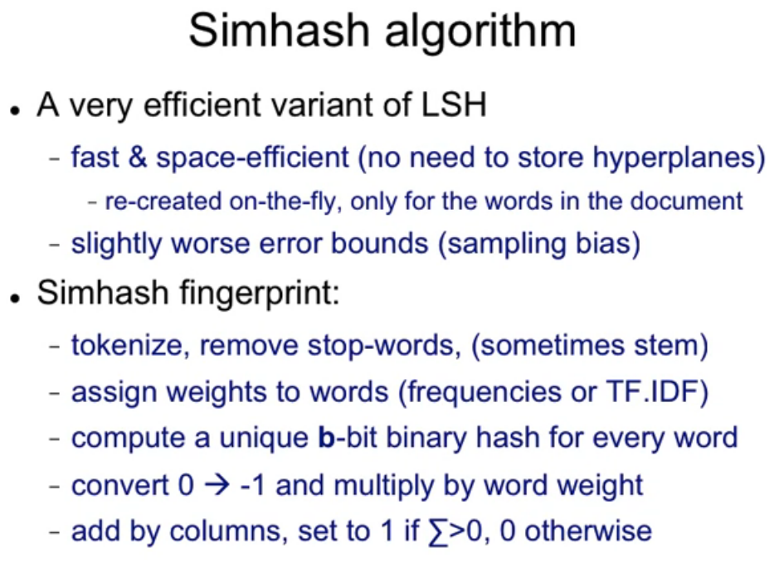

Slide 33
